Slide 1
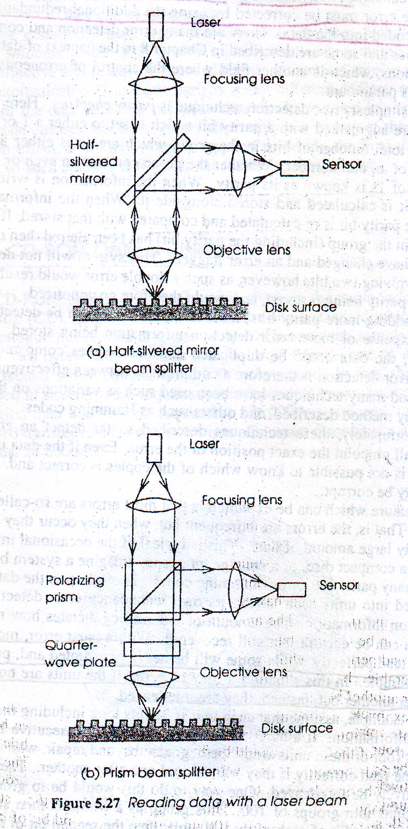
Optical Reading Mechanism

Slide 2
Optical Recording Codes
Optical recording requires much larger degree of error detection and correction
Error Detection technique:
  Parity Checking
    Groups of bits are augmented with a parity bit which is set to either ‘0’ or ‘1’ – so that total number of ‘1’ s are either an even number or an odd number
    When information is written – parity bit is calculated and stored alongside it
    When information is read – parity bit is re-calculated and compared with that stored
    Problem: cannot detect error involving two bits

Slide 3
Problem
Two bit errors cannot be handled
If there is another even number of 1, we can’t distinguish.

Slide 4
Solution
Hamming code
Using Multiple number of parities

Slide 5
Problem of using Hamming Code
It can’t pinpoint where the error is
If data is duplicate ,it can’t find which one is real and which is duplicated data

Slide 6
Problem of
Using Multiple number of parities
Multiple number of parities will take more space.

Slide 7
Duplicated data
Burst Error:
  When error occur they affect relatively large amount of data
  Compact disc
  Burst error can affect many individual units, but only a small part of each is corrupted
      So they can be recovered

Slide 8
Reed Solomon Code
  error detection and correction technique
  Effective and relatively space efficient
  Involves interleaving automatically

